Slide 1
Help, the PE must be online!
Manager's guide

Slide 2
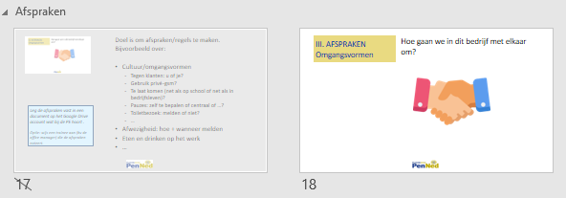
BLOCK 1
Working day 1 | Introduction of the PE (roughly as in sheets 8 to 17 of Arianne’s PowerPoint) Log in to penned.nl and go to My PE (there is already a welcome text; compare sheets 27 to 31 of the Powerpoint) Determining the assortment (introductory story, then have the business guide browsed through in pairs, and have suggestions made by pairs, then have them make choices in groups of 4, which present in class and let them decide in class. Or else, let everyone come up with 2 articles, with description, price etc.
Block 1 Introduction of the PE Video about PE See slide 8-17
Explanation PenNed.nl + My PE slide 27-31
Determine assortment

Slide 3
BLOCK 1 - teacher
Programme
Introduction of the PE * Video about the PE
Block 1 Introduction of the PE Video about PE See slide 8-17
Explanation PenNed.nl + My PE slide 27-31
Determine assortment
Working day 1 | Introduction of the PE (roughly as in sheets 8 to 17 of Arianne’s PowerPoint) Log in to penned.nl and go to My PE (there is already a welcome text; compare sheets 27 to 31 of the Powerpoint) Determining the assortment (introductory story, then have the business guide browsed through in pairs, and have two suggestions made, then have them make choices in groups of 4, which present in class and let them decide in class. Or else let everyone come up with 2 articles, with description, price etc.

Slide 4
Block 2
Working day 2 | Commerce/Marketing Which sales channels are we going to use? Which target groups do we want to reach? In which countries do we want to be active? Again consulting business guide. And then have a flyer, action, logo and/or e-mail text made. And then have them made with Google Docs and save them in Google Drive (or the Microsoft variant) Finally, let them choose the best email text and actually send it via Gmail: "We are Vlaggensite. We... Are opening..... "

Slide 5
Block 3
Working day 3 | Buying What do we need as a company? Let everyone write that down. And then look up in the business guide where we can buy it. Tell us that we can also buy some goods at the GHMP. And then have e-mails written to ask for information (or to request quotes right away). Or by phone to ask for information (e.g. have call script made). And then actually let some people call.

Slide 6
Block 4
Working day 4 | Build website Have figured out the nicest website in Business Guide. Training in the website builder (at the school's choice). (with the assignment that the name of the company and at least 1 article will be included, with buy-button)

Slide 7
Block 5
Working day 5 | Exact Online Work-in programme Exact Online

Slide 8
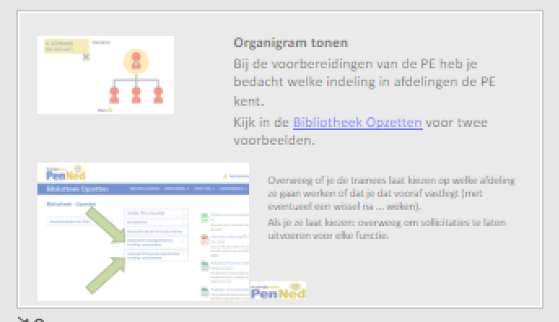
Block 6
Working day 6 | Objective / social policy What will be the business objective/vision? Also determine with each other. Are we going to give the staff salary later? Yes, how much then? Have figured out what that is in reality and how much they are going to earn as trainees who work x hours a week. Organization chart of Vlaggensite (Show and Explain Trello) (powerpoint sheets 18 and 19) Then apply for positions. Write letter of application.

Slide 9
Block 7
Working day 7 | Job interviews

Slide 10
Block 8
Working day 8 | Start the day with appointments and introduction (such as powerpoint sheets 20 and 21, and 23). And then: get started! In the Trello, I would have pretty precise instructions on how to perform that task. Several appointments that are now in the Powerpoint would be on those task cards, which I would not tell in class.

Slide 11
CONTENTS
Info for the manager
About this manual
Do
Starting points
Tips
Kick off of the online PE (with trainees)
Introduction en Introduction
What is a PE?
Agreements
You should know this
Get started
Conclusion
Info for the manager
How to continue
Useful information

Slide 12
About this manual
This guide contains a simple roadmap to start an online PE. Included is an online kick-off meeting for the trainees
Grey pages are teacher pages. These are in front of the corresponding pages for trainees and have been set to Hide. In the upper left corner of a teacher page, you can see which slide it belongs to
MA = manager (accompanying teacher) / PE = practice enterprise / Trainee = student as an employee in the PE
Both for physical meetings and for use online
Symbol for Symbol for
physical meetings: online contact:
Adapt to your own wishes and the specifics of your PE
Symbol to e.g. adjust something

Slide 13
To do
Customize this presentation in the corporate identity of your PE or your school.
Edit the presentation: complete with data of your own PE and remove parts you don't think apply.
If this symbol is on a page, you still need to customize/add things yourself.

Slide 14
Principles
The design of the PE has been finalized
The components of the roadmap have all been completed and elaborated in detail.
The Start to Practice training has been done by all managers.
Already present/ known / registered
unless it has been chosen to determine all these components together with the student
PE-name
2 shelf-ready products + corresponding prices
Organization chart + job descriptions See example-PEs in Create Library
which departments can be distinguished?
which activities belong to each department?
Process flow has been described See example-PEs in Create Library
what steps in the purchasing process?
What steps can be distinguished in the sales process? What documents/systems + which department does what, when?
Who keeps up with the emails/ makes tasks from emails?

Slide 15
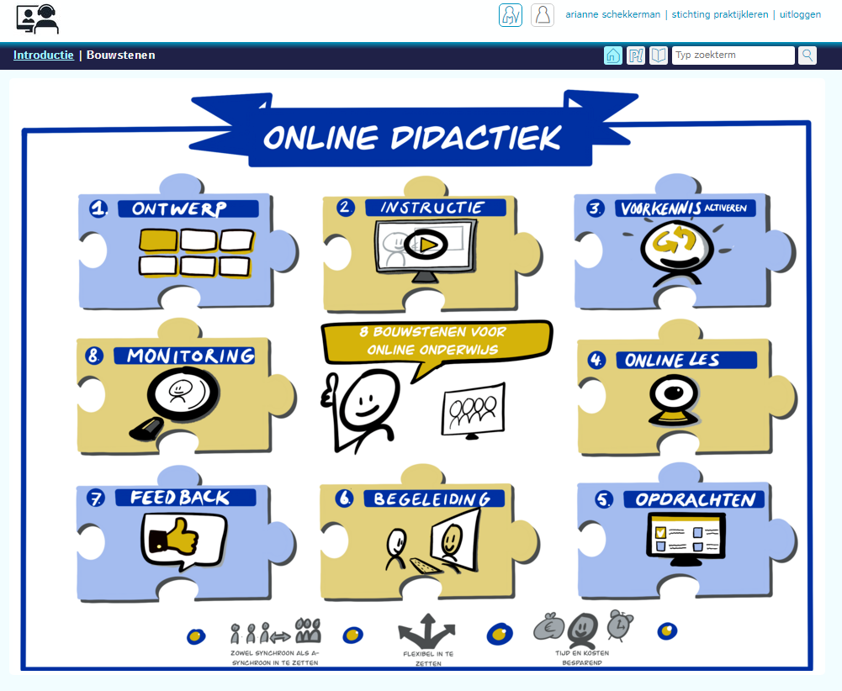
Tips
Check out the online didactics module of Stichting Praktijkleren
https://www.stichtingpraktijkleren.nl/oo/online-didactics/
(log in to the site of Stichting Praktijkleren)
Check out this series of blogs about online teaching through MS Teams. Here you'll find a a large amount of information about everything Teams has to offer and how to use it for educational meetings online.
https://socialmediainvocationaleducation.nl/office365/microsoft-teams-manuals-for-schools/
source: Office 365 in vocational education
Ashwin Brouwer (Friesland College) and Annet Smith (Nova College) write about Office 365 in intermediate vocational education here. Ashwin en Annet both are Microsoft Innovative Educator Expert. Office 365 in intermediate vocational education is a publication of Social media in intermediate vocational education.
Check out these tips on digital etiquette for MS Teams
https://www.managementsupport.nl/working-digitally/news/2020/08/digital-etiquette-microsoft-teams-10118681?_ga=2.3947440.1659834782.1597770034-2064962137.1597770034
Source: Managementsupport.nl

Slide 16
Preparation Kick off meeting
Have the PE hours included in the time table under the PE name, possibly as a practice enterprise or if applicable as professional practical training hours.
Send your trainees an invitation (from the BL-mail) for a kick-off meeting or for a 1st work meeting (=1st contact moment).
Include a link to the meeting (Teams or Google Meet or ...)
Ask the participants to test image and sound in advance (during the online meeting all trainees and managers have their camera switched on)
If a trainee does not have a webcam: have the trainee install a free app on the smartphone.
Android + Windows: Droidapp
Iphone + Mac: Iriun Webcam
More information: https://tweakers.net/reviews/7756/3/five-workingathome-webcams-tested-your-smartphone-or-photo-camera-as-webcam.html

Slide 17
Kick off: Introduction PenNed and [name PE]
Name PE
Logo PE
Name MA(nager)

Slide 18
Start right away in your role as a manager.
For instance: Welcome to the company [name PE]! I'm glad you're going to work together with me to make this company a success.
Let everyone tell their name and what work experience they have.
Ask everyone to enter their account name correctly on the online screen

Slide 19
I. INTRODUCTION
Welcome team [PE name]
Who are you?
What work experience do you have?
....

Slide 20
Video about working in a PE
Options for use
Let trainees talk about their side job: which departments do they know there and are there certain procedures between departments?
Show the video
Ask trainees if they see similarities and differences between their side jobs
Show video again and pause to present the PE per part (main lines only)
Or
Present the PE (broadly speaking)
Let groups of trainees watch the video and have them translate to their own PE with each part

Slide 21
II. What is a PE?
Working in a PE
https://www.youtube.com/watch?v=qolr2T7LDu4

Slide 22
The 2 slides below give a summary of what a PE entails.
Processes, procedures, interaction and communication are real!

Slide 23
A PE is a virtual practice company
Practice company
Purchasing and selling (commercial) goods to customers from all over the world
Manager + trainees ->organized in departments
Each department has its own activities
Cooperation necessary because of interdependence
PE has its own corporate identity, own appointments, own culture

Slide 24
A PE is a virtual practice company
Virtual
Almost real!
Via online systems
But
Withdrawing money (from bank account) is not possible
Products are not really delivered (packing slip counts as delivery)
Customers are people in training (NL: mainly intermediate vocational education students and adult education)

Slide 25
Goal is to make arrangements/rules. For example, about:
Culture/Manners
To customers: Dutch: U or jij?
Use private cell phone?
Being late (just like in school or just like in business)?
Breaks: self-determination whether central or ...?
Toilet visit: report or not?
...
Absence: how + when to report
Food and drinks at work…
Record the arrangements in a document on the Google Drive account that comes with the PE. Option: appoint a trainee (e.g. the office manager) who writes down the appointments.

Slide 26
III. ARRANGEMENTS Manners
How do we interact in this company?

Slide 27
Show organization chart
During the preparations of the PE you have thought about which classification in departments the PE has.
Check Setting up library for two examples.
Consider whether you let the trainees choose which department they are going to work in or whether you will pre-commit it (with a possible change after ... weeks).
If you let them choose: Consider having applications for each position.

Slide 28
III. ARRANGEMENTS Who ?
Organization chart

Slide 29
Day start – Individual
Preparation:
Make sure that the trainees are ‘created’ in the Portal and that you have all the login info available for them.
➔ See video Trainees and their portalrights in the Business Library (login required for managers)
This means a fixed routine that the trainees perform before they start their tasks and consultations.
The goal is to make sure that everyone has all the necessary information at hand.

Slide 30
III. ARRANGEMENTS Starting your working day
Start of the day – to be executed individually
This is what you do first every working day: open needed websites/files
PenNed website + login (=MyPE)
PE portal (banking environment, etc.)
Website of the own PE
Gmail of the PE and other Google apps
Calendar and To-Do list [e.g. in Trello or Google calendar + Google Tasks]
List of employees/ Phone book
Organization Chart of the PE
See below for examples and links the pages
You should know this
Make sure the info here matches the info on this slide

Slide 31
Collective start of the day = work consultation via Teams (or GoogleMeet)
Have someone write down appointments and create a list of actions
Show appointments and actions (e.g. in calendar, on scheduling board or flipover or ...)
End of the day: check agreements and actions; have they been implemented?
Complexity of work consultation and the length of the list of actions can increase the longer the PE runs. Trainee can therefore take on the role of chairman.
Watch here a video of what a joint start of the working day/week can look like.
NB: Make sure you are first logged in as a manager of the PenNed website .
Trainees do not have access to this video

Slide 32
III. ARRANGEMENTS Start of the day/week
Start of the day/week - collectively
Work consultation via Teams (or GoogleMeet)
Discuss:
Work that is ready
Work that needs to be done today/this week
Details /expected challenges
Planning next week
Other matters that are of interest
Questions
...

Slide 33
Prepare
Make sure files are stored with clear names.
If necessary, have the office manager/ICT/assistant manager set up a format for this later.
Create a folder structure in the PE's Google Drive (pe.nl01xxx@penned.nl).
For example, create a folder for each department. Later, subfolders may be needed, but the trainees (or ICT/office manager) can set them up themselves.
See the Extra Info section at the back for more information about the use of the Google-account

Slide 34
VI. HERE'S WHAT YOU NEED TO KNOW Files and storage locations/sites
Files and storage locations/sites
Creating files ➔ always create files using Google Docs ( Format file name: [...]
Save files in Google Drive Folder Tree
Always email from PE mail (Gmail) with first name last name + department
Documents - Spreadsheets - Presentations
are the Googleversions of Word – Excel - Powerpoint

Slide 35
Login PenNed Website
After logging in, you'll immediately get to your own PE page MyPE (see explanation below).
Logging in does not result in additional library files for trainees. As a manager, you'll see additional files after logging in.
Login website and portal for trainees
After creating trainee, login name and password follows. Tip: Let student log in at 1st x and change the password and perhaps write it down.
As a manager, you can always see the trainee's password in menu Practice Firm Admin. There you can also reset the password.
Username = always: first name.last name.xxx (xxx = last 3 digits PE code)
➔ See video Trainees And their portalrights in the Business Library (login if BL required)

Slide 36
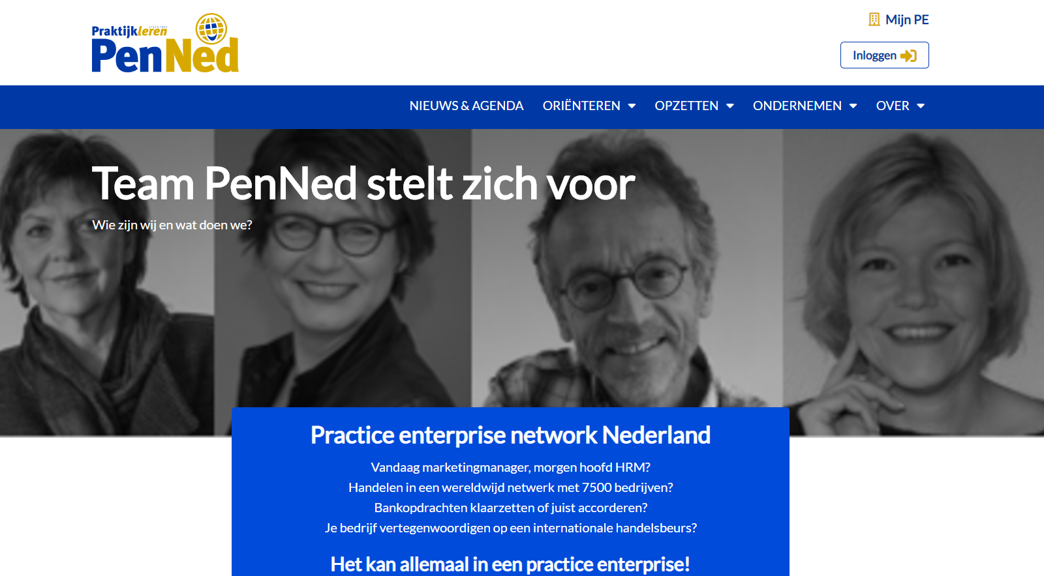
VI. HERE'S WHAT YOU NEED TO KNOW Sites and login info - 1
PenNed Website + MyPE
www.penned.nl
MyPE (dashboard + intranet of own PE)
See green arrow
user name + password = equal to portal login [first name.last name.xxx]
Handy pages PenNed website:
Business menu Information about various things the course of events in a PE
Business library Information and explanations about practical things involved in business
E.g. Using Google Drive, creating a webshop

Slide 37
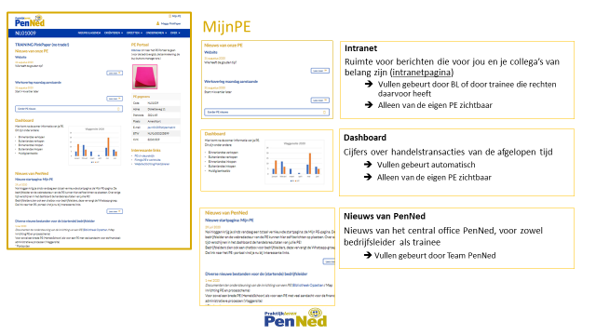
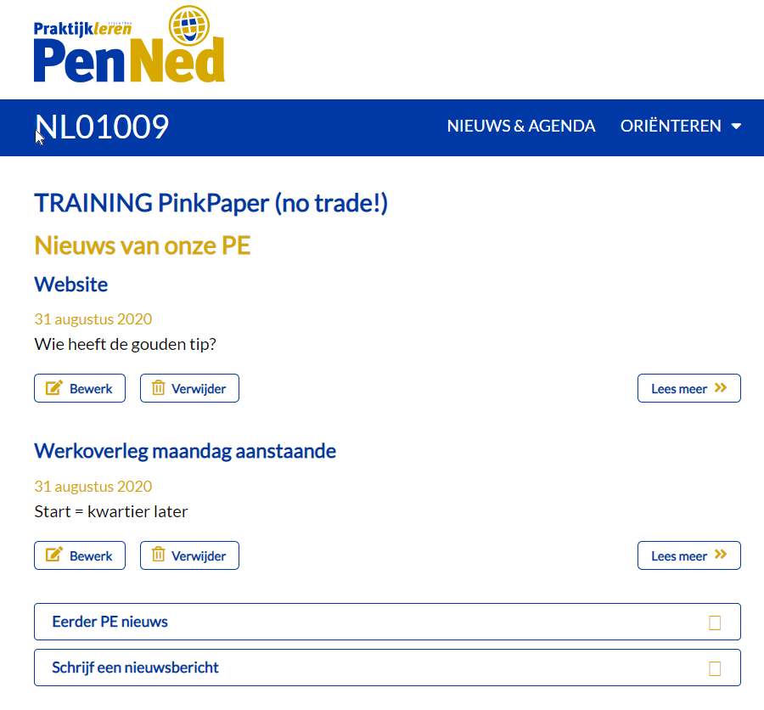
Explanation MyPE
Explanation function of each part
Info on how this part is filled.
Tip
Post some news in MyPE
Make sure you're logged in as a business manager and choose Write a news story
Do you want to give a trainee the rights to write news stories? ➔ Mail PenNed@stichtingpraktijkleren.nl for a web editor account.

Slide 38
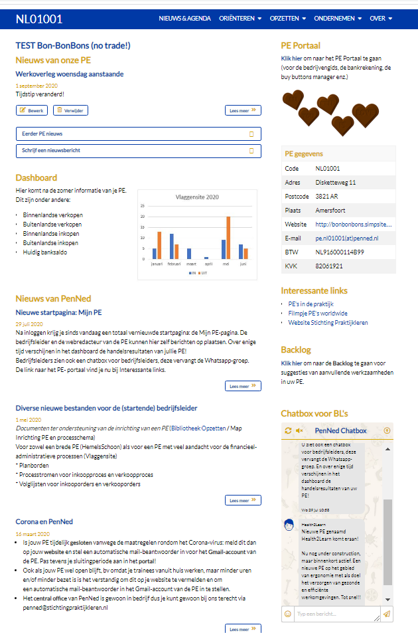
MyPE – additional features for managers
Backlog
Suggestions for additional work for trainees Teacher-oriented, so don't let trainees log into your manager (MA) account
See here for more info.
Chatbox
To quickly ask a question, to spar, to exchange ideas, ... Teacher-focused, so don't let trainees log into your MA account

Slide 39
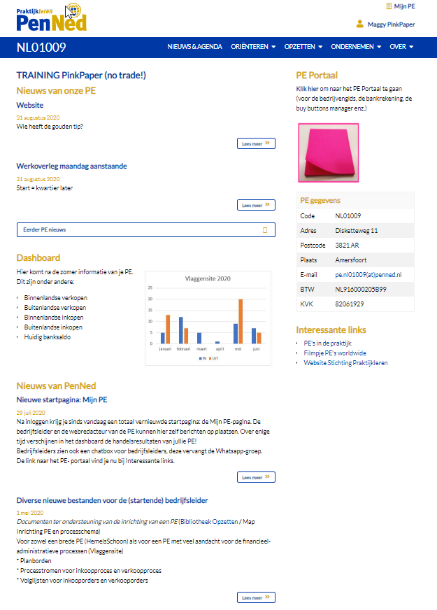
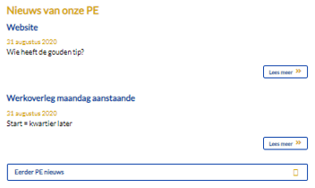
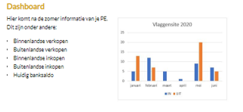
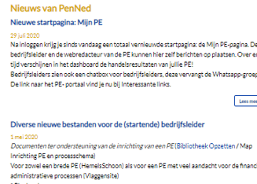
MyPE
(*)
Intranet
Space for messages that matter to you and your colleagues (intranet page)
Filling is done by MA or by trainee who has rights to do so (*)
Only visible for the own PE
Dashboard
Figures on recent business transactions
Filling is done automatically
Only visible for your own PE
News from PenNed
News from the central office PenNed
Filling is done by Team PenNed
Only visible to manager
(*) Mail to PenNed@stichtingpraktijkleren.nl to request a web editor account so that a trainee can also post messages.

Slide 40
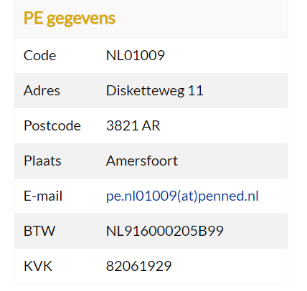
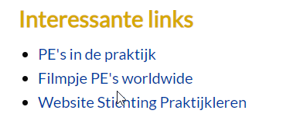
MyPE
PE Portal
Here you log in to go to the PE portal, or to the bank account, the buy button, the Business Guide.
PE details
Contact details and VAT and Chamber of Commerce number together
Filling is done automatically
Only visible from your own PE
Interesting links
Links to interesting sites can be anything. For example, to new files in the PenNed website libraries
Supplied by Central Office PenNed

Slide 41
Login Gmail and Google apps for PE
User ID = pe.nl01xxx@penned.nl
Password = [...]
This password can be changed by
Settings (top right), cog wheel)
All settings
Accounts
Change account settings
Google Account settings
Security
Login to Google
➔ It is not useful if trainees work with their own email address (neither from Google nor through another account). As a result, sent e-mails cannot be centrally traced and/or fileable and therefore you cannot keep an overview. Therefore, make the trainees used to always email via the PE-mail and to sign mails with their name and department.
➔ All Google apps (including Gmail) allow you to log in with multiples at the same time, so individual accounts are not required.
The 3x3 dots in the top right now give you access to Google Drive and all other Google apps

Slide 42
Google's handy apps
Drive: Because of central location that is accessible to everyone (create folders by department)
Docs/Sheets/Slides of Documents/Spreadsheets/Presentations: similar to Word, Excel and Powerpoint
Calendar/Calendar: To record tasks, deadlines, and meetings
Tasks: to set tasks and deadlines
Keep: to take notes
Meets: to meet online
Forms: to create online surveys and fill-in forms
➔ It is not useful if trainees work with their own email address (neither Google nor through another account). As a result, sent e-mails are not centrally detectable and/or fileable and therefore you cannot keep an overview. Therefore, make the trainees used to always email via the PE-mail and to sign mails with their name and department.
➔ All Google apps (including Gmail) allow you to log in with multiples at the same time, so individual accounts are not required.
The 3x3 dots in the top right now give you access to Google Drive and all other Google apps

Slide 43
VI. HERE'S WHAT YOU NEED TO KNOW Sites and login info - 2
Gmail of the PE / other Google apps
All communication with the outside world is via the Gmail address of the PE
Option 1: via https://www.google.com/
In the upper-right corner, click Login, and then enter the PE's username and password
then click Gmail in the upper-right corner
Option 2: from an existing Gmail account
Click your photo/avatar in the upper-right corner and choose Add another account
Enter the PE's username and password
Login
Username = pe.nl01xxx@penned.nl
Password = ...

Slide 44
Google applications for the PE
If you're logged into Gmail, you can use the 3x3 dots in the top right corner of Google's other applications:
Drive (file storage)
Documents + Spreadsheets + Presentations ➔ online versions of Word, Excel, and PowerPoint
Agenda ➔ for PE appointments
Sites ➔ to create a simple website
Contacts ➔ for your customer base
Tasks ➔ for tasks and deadlines
➔ In all Google apps (including Gmail), you can log in and work with multiples at the same time, so individual accounts are not required.

Slide 45
Google applications for the PE
Use the Help feature in Google
Check your calendar, notes, or tasks
On a computer, go to Gmail, Calendar, or a file in Google Docs, Spreadsheets, or Presentations.
On the right, choose Calendar:
Review your schedule and add or edit appointments.
Keep: Create a note or list.
Tasks: Add to-do lists and deadlines.
➔ You open/close the right sidebar via the arrow at the bottom right

Slide 46
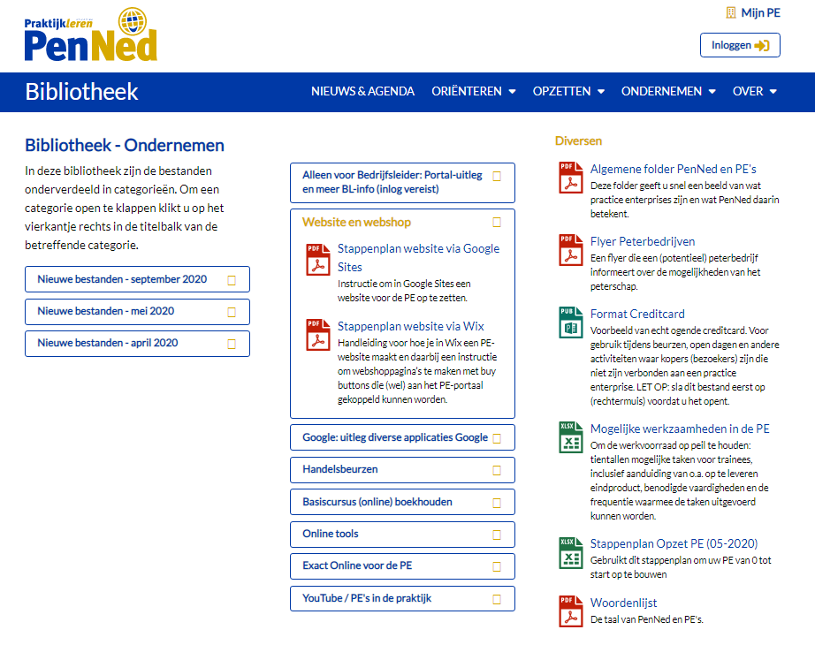
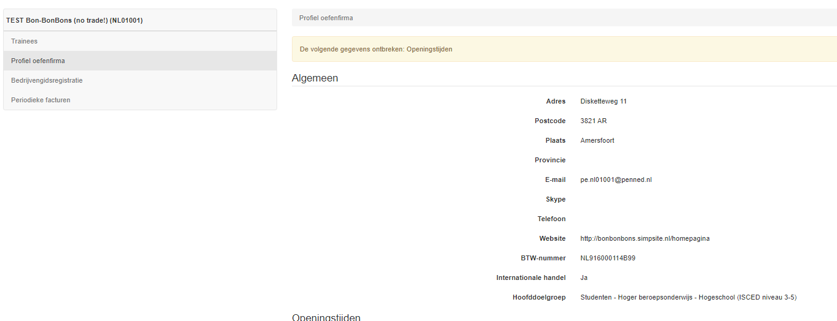
The PE’s website
Read here tips and tools on setting up a website with webshop
Look in the business-library website and webshop section for step-by-step plans how to tackle things
Quick start with a webshop? Ask if team PenNed creates a basic site for you.
Don't forget to insert the created website into the admin menu of the portal, so that it is linked to the Business Guide and becomes visible and usable for other Pe's.

Slide 47
VI. HERE'S WHAT YOU NEED TO KNOW Sites and login info - 3
Website of the own PE
The website of our PE is/is made in ... [platform name]
URL: = ...
Username = ...
Password = ...

Slide 48
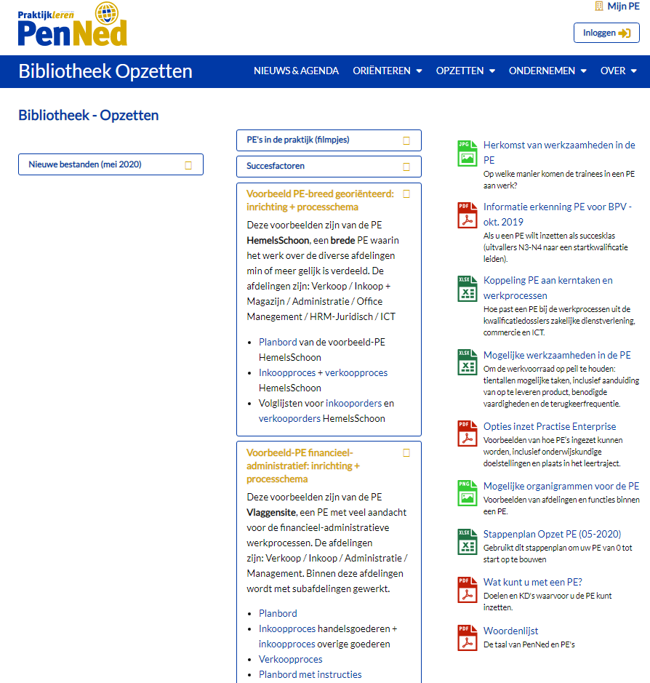
To-do list / Calendar / Planner
It is useful to keep an online to-do list and/or planner.
Use Google Calendar with Google Tasks or choose Trello or Padlet
Login Info for example....
In the Set up library you will find 2 examples of plan boards in Trello. If desired, you can get a copy at PenNed@stichtingpraktijkleren.nl. You can edit that copy yourself: e.g. adjust the cards, add files as an attachment, create additional columns, ...

Slide 49
VI. DIT MOET JE WETEN Sites en inloginfo - 4
Takenlijst / Agenda / Planner
Agenda:
Takenlijst / Planner:

Slide 50
Handige bestanden
Geef hier aan welke bestanden de trainee altijd bij de hand moet hebben
Vindplaats …
Eventueel inloginfo ….
Wie mag bewerken?
Nieuwe versies opslaan onder naam ….
Zorg dat de info hier matcht met de info op deze dia

Slide 51
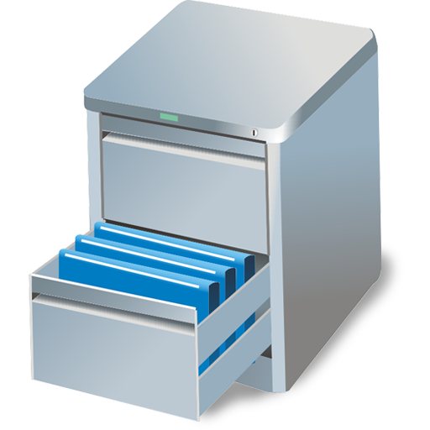
VI. HERE'S WHAT YOU NEED TO KNOW Files
Files you need
Organization chart
Location: …
List of employees
Location: …
….
Location: …

Slide 52
Programme after introduction
Make sure you have a number of tasks available per department➔ use the PE plan board/to-do list (see earlier) or any other way to communicate it centrally.
Make sure that the trainees can work together on a department-by-department basis. E.g. by creating group chats, channels or breakout rooms.
Start simple: let everyone log in and look around. Be sure to let the snooping in the Business Guide in the portal. Company Guide explanation
Gebruik de chat function for questions and remarks.
Agree on what you want to see this working day as the end result per department. Name how/where you want to see those results.
Schedule time for a first-day review.
Walk around by connecting to the channels, breakout rooms or group chats.
Need inspiration? Take a look at the backlog (see next page)

Slide 53
Backlog
Suggestions for additional work for trainees
Type of assignments ‘bank’
sorted by PE department and by 21st-century skills including extensive search
no (example) elaboration because whether the product is 'good' depends on the context of your PE. And maybe the process is more important than the actual output...
Ideas for even more activities are welcome!
Teacher-focused, so don't let trainees log into your MA (manager)account
Login➔ with your stichtingpraktijkleren-account
and not with your PenNed (managers) account

Slide 54
VII. GET STARTED
PROGRAMME FOR TODAY
Work with the people in your department through.…
You can find your activities on/in….
Need help?
ask your colleague for help
use the Teams chat feature
End of working day➔ joint closure
via:
time:

Slide 55
Evaluate first work experiences in the PE
Can a trainee find what he needs?
Are the processes broadly clear?
Does the trainee know what to do (the next working day)?
How does the trainee feel in the PE?
For example, use a poll /Google Forms/Kahoot/write on Teams whiteboard
Organization working from home by trainees
What times: fixed day parts/own choice/...
How to ask BL questions?
Work carried out
How/Where to Leave: In GoogleDrive/Show at Next Consultation/...?
Who updates action list/to-do list/plan board?
When update: immediately if handled/in subsequent consultation /...
Available for questions
Plan a moment (in the timetable) when you are present online in the PE
Next online meeting
Date and time
What should trainee start/keep ready

Slide 56
VIII. Closing
How was your working day in the PE?
Questions and comments
Working from home for the PE
When? ➔ fixed moments or at your own choice? ...
Make work made available through ...
When to update plan board
Manager available for questions
Via... (mail/chat/...)
On... day of ... To...
Next online meeting:

Slide 57
How to proceed?
Work on the basis of the agreements made on slide VIII. Closing
Make sure you are available to answer questions at the agreed time
Prepare for the next online consultation
Evaluate the behaviour of the trainees/departments: degree of own initiative/ self-employment/ taking responsibility
Evaluate the work carried out: what went well and what has not yet?➔ focus on practices and process in relation to agreements made.
Check out last time's action list/to-task/plan board: what can be ticked off?
Get a new stock for next week
As soon as possible: appoint a minutes secretary who keeps action list/planboard (via screen sharing so everyone can watch)
As soon as you act: check out the current figures in MyPE and point out trainees immediately on the news
Set quality requirements for the PE and discuss them with the trainees
External: see following page
Internal: ...
Make them a fixed agenda item of any consultation.
Work towards self-employed trainees/departments: teach the trainees to ask questions to colleagues in their own department first and point them to all materials in the Library of the PenNed website

Slide 58
External quality requirements
➔ Come from the Roadmap PE design
See Set Up Library (left column)
Continuous | Being contactable by phone / ensuring that phone is picked up during opening hours
Continuous | No later than 7 business days response to received emails
Continuous | Information in the Business Guide is up to date (opening hours, closing periods, etc)
Continuous | All skilled managers (also teachers in training, etc!)
Continuous | Invoices are paid within 10 working days (invoices PenNed-services and orders)
Continuous | Orders are delivered within 10 working days
No later than 2 weeks after start | Purchase transactions made for the PE (e.g. furniture, consumables, and raw materials)
No later than 2 weeks after start | At least 3 ready-to-sell products ready
No later than 2 weeks after start | Professional website with 3 marketable products, working buy buttons, correct contact info and disclaimer
No later than 2 weeks after start | Salaries paid to trainees and thus made private purchases

Slide 59
Useful information
Module online didactics of Stichting Praktijkleren
https://www.stichtingpraktijkleren.nl/oo/online-didactiek/
Comprehensive blogs about Teams in education
https://socialmediainvocationaleducation.nl/office365/microsoft-teams-manuals-for-schools/
Video: A working day in a PE
Video: online start of the week PE
For questions or help: Email penned@stichtingpraktijkleren.nl

